Slide 1

Bahria University Karachi Campus
Data Mining
K Nearest Neighbors
Department of Software Engineering
Bahria University Karachi Campus

Slide 2
Eager Learners
The classification methods discussed so far in this course—decision tree , Bayesian classification, etc—are all examples of eager learners.
Eager learners, when given a set of training tuples, will construct a generalization (i.e., classification) model before receiving new (e.g., test) tuples to classify.
We can think of the learned model as being ready and eager to classify previously unseen tuples.

Slide 3
Lazy Learners
Imagine a contrasting lazy approach, in which the learner instead waits until the last minute before doing any model construction in order to classify a given test tuple.
That is, when given a training tuple, a lazy learner simply stores it (or does only a little minor processing) and waits until it is given a test tuple.
Only when it sees the test tuple does it perform generalization in order to classify the tuple based on its similarity to the stored training tuples.
Notes:
Doesn’t learn itself rather they follow the process.

Slide 4
Instance-based Learning
In instance-based learning the training examples are stored verbatim, and a distance function is used to determine which member of the training set is closest to an unknown test instance.
Once the nearest training instance has been located, its class is predicted for the test instance.
The only remaining problem is defining the distance function, and that is not very difficult to do, particularly if the attributes are numeric.
Notes:
verbatim= exactly same words as used original

Slide 5
Basic idea:
If it walks like a duck, quacks like a duck, then it’s probably a duck
Compute Distance
Test Record
Training Records
Choose k of the “nearest” records

Slide 6
Distance Function
Although there are other possible choices, most instance-based learners use Euclidean distance.
When comparing distances it is not necessary to perform the square root operation; the sums of squares can be compared directly.
One alternative to the Euclidean distance is the Manhattan or city-block metric, where the difference between attribute values is not squared but just added up (after taking the absolute value).

Slide 7
Normalization
Different attributes are measured on different scales, so if the Euclidean distance formula were used directly, the effects of some attributes might be completely dwarfed by others that had larger scales of measurement.
Consequently, it is usual to normalize all attribute values to lie between 0 and 1.
Notes:
Dwarfed= small

Slide 8
Distance for Categorical Attributes
For categorical attributes, a simple method is to compare the corresponding value of the attribute in tuple X1 with that in tuple X2.
If the two are identical (e.g., tuples X1 and X2 both have the color blue), then the difference between the two is taken as 0.
If the two are different (e.g., tuple X1 is blue but tuple X2 is red), then the difference is considered to be 1.

Slide 9
K-Nearest Neighbor
The k-nearest-neighbor method was first described in the early 1950s.
The method is labor intensive when given large training sets, and did not gain popularity until the 1960s when increased computing power became available.
It has since been widely used in the area of pattern recognition.
Notes:
https://www.youtube.com/watch?v=CJjSPCslxqQ
Chapt 9.5.1

Slide 10
Definition of Nearest Neighbor
K-nearest neighbors of a record x are data points that have the k smallest distances to x

Slide 11
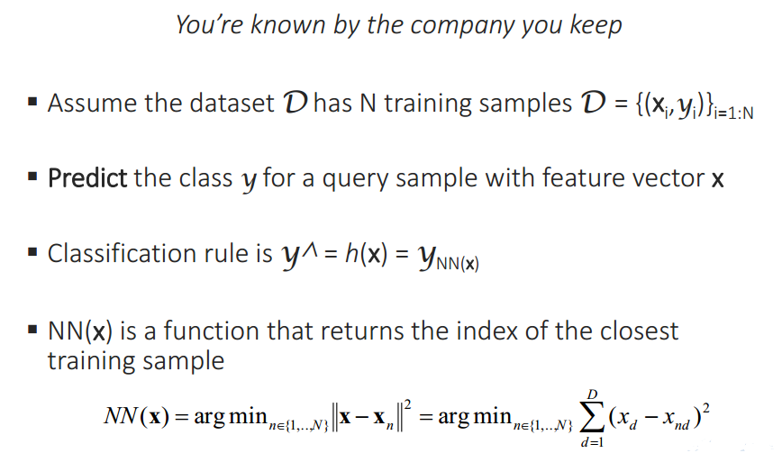
Cont….
Notes:
NN= Nearest Neighbor

Slide 12

Example: Recognizing Flowers

Slide 13
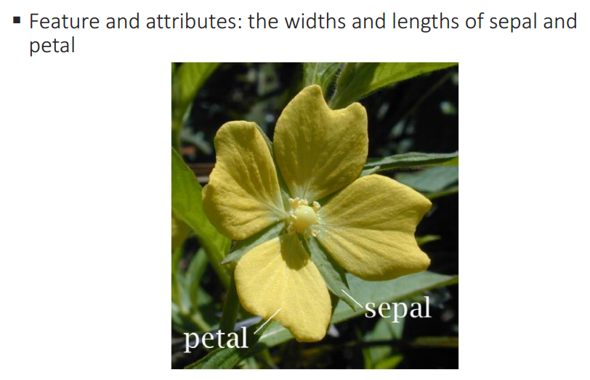
Properties of the flowers
Notes:
4 Features, 3 classes

Slide 14
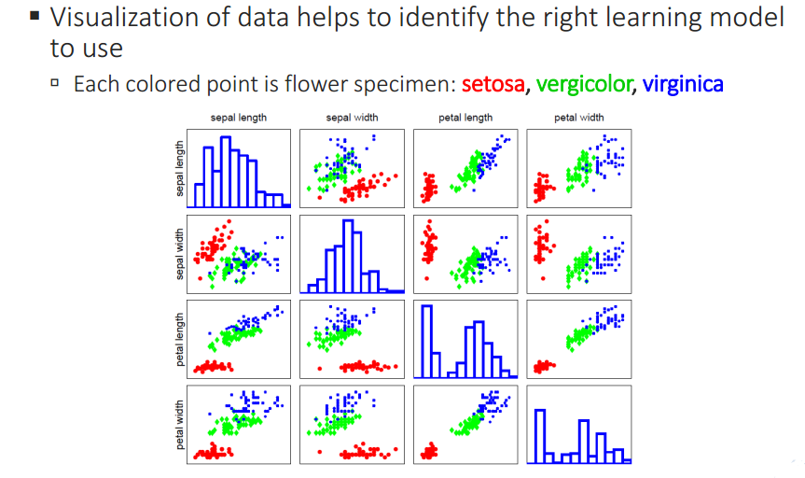
Visualization of data
Fig: Pairwise scatter plots of 131 Flower specimens

Slide 15
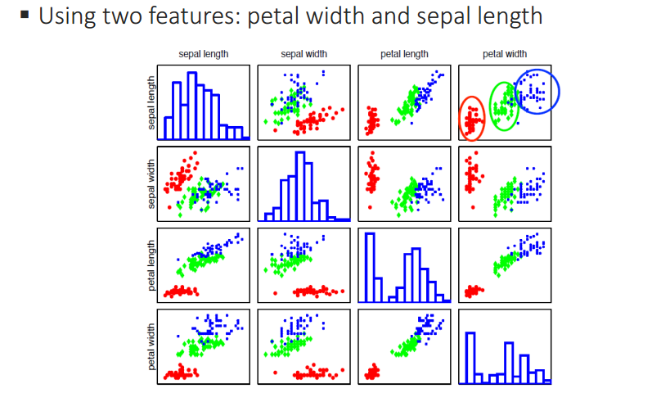
Different types seem well-clustered and separable

Slide 16
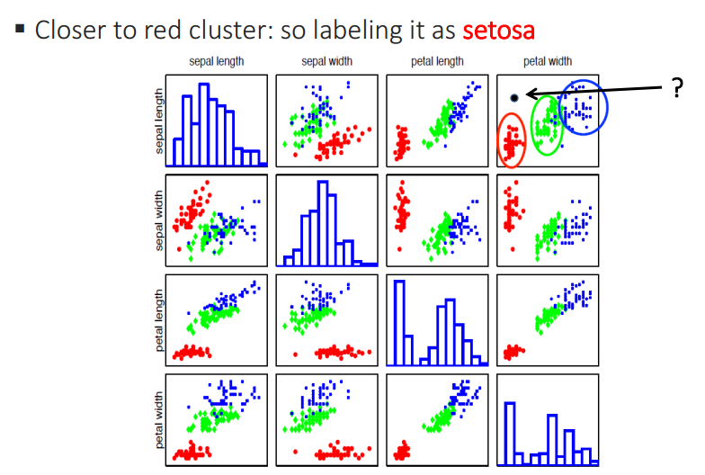
Labeling and unknown flower type

Slide 17
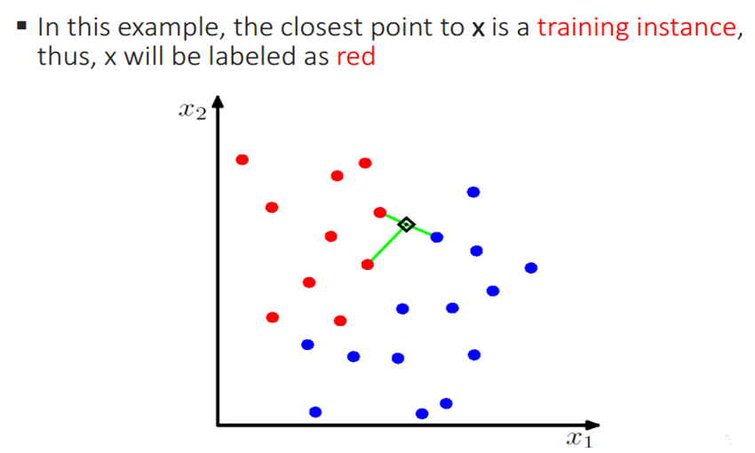
Example

Slide 18
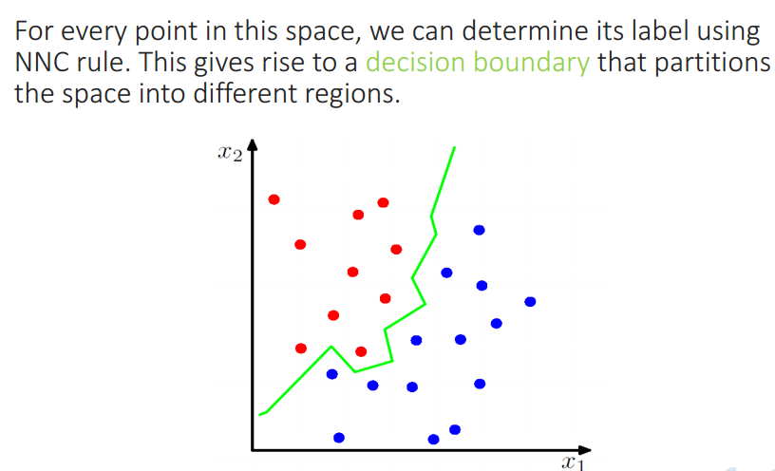
Decision boundary
Notes:
NNC: Nearest Neighbor Class

Slide 19
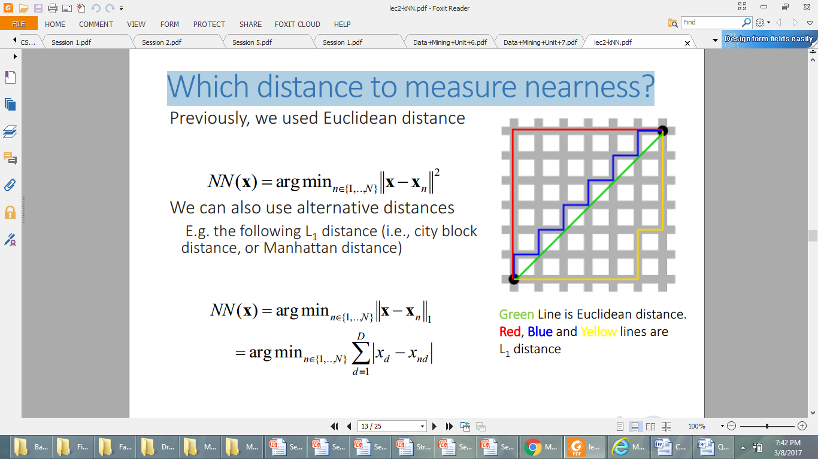
Which distance to measure nearness?

Slide 20
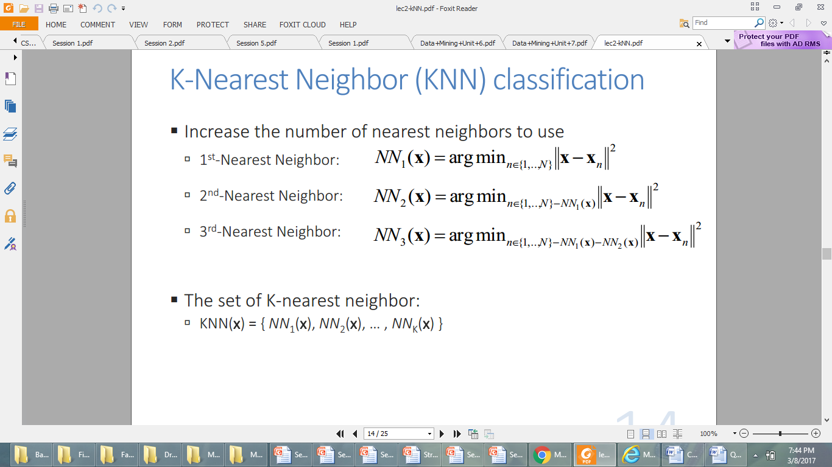
K-Nearest Neighbor (KNN) Classification

Slide 21
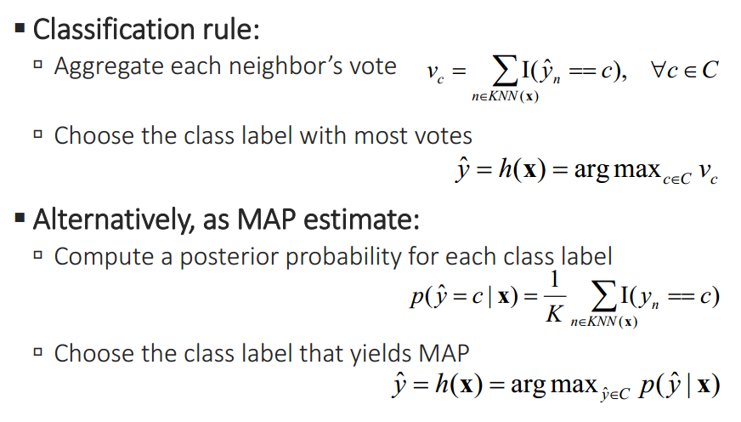
Cont….

Slide 22
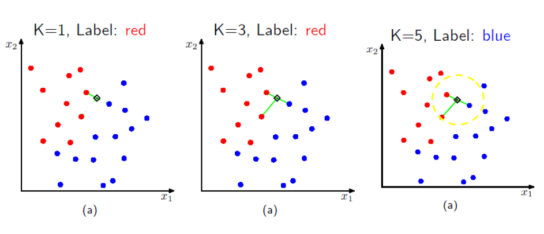
Example

Slide 23
Right Value for K?
A good value for K can be determined experimentally.
Starting with k = 1, we use a test set to estimate the error rate of the classifier.
This process can be repeated each time by increasing k to allow for one more neighbor.
The k value that gives the minimum error rate may be selected.
In general, the larger the number of training tuples is, the larger the value of k will be (so that classification and prediction decisions can be based on a larger portion of the stored tuples).

Slide 24
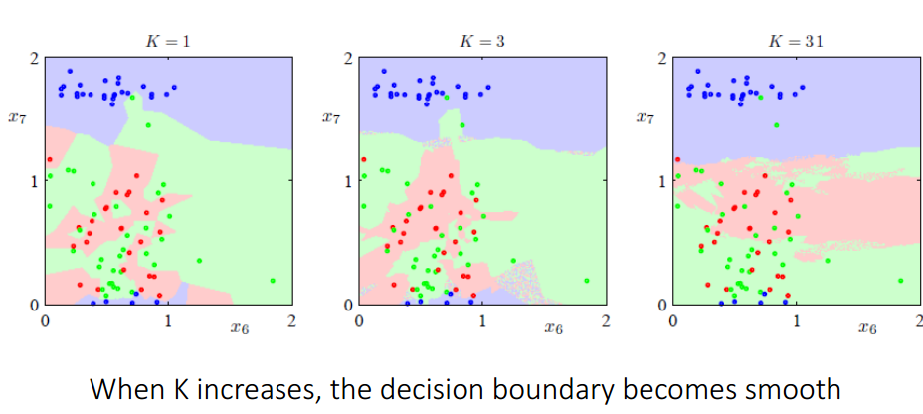
Cont….

Slide 25
Low Training Time
Unlike eager learning methods, lazy learners do less work when a training tuple is presented and more work when making a classification or prediction.
Because lazy learners store the training tuples or “instances,” they are also referred to as instance based learners, even though all learning is essentially based on instances.

Slide 26
High Prediction Time
Although instance-based learning is simple and effective, it is often slow.
The obvious way to find which member of the training set is closest to an unknown test instance is to calculate the distance from every member of the training set and select the smallest.
This procedure is linear in the number of training instances: in other words, the time it takes to make a single prediction is proportional to the number of training instances.

Slide 27
High Prediction Time (Cont’d)
When making a classification or prediction, lazy learners can be computationally expensive.
They require efficient storage techniques and are suited to implementation on parallel hardware.
They offer little explanation or insight into the structure of the data.
Lazy learners, however, naturally support incremental learning.
They are able to model complex decision spaces having hyper polygonal shapes that may not be as easily describable by other learning algorithms (such as hyper-rectangular shapes modeled by decision trees).

Slide 28
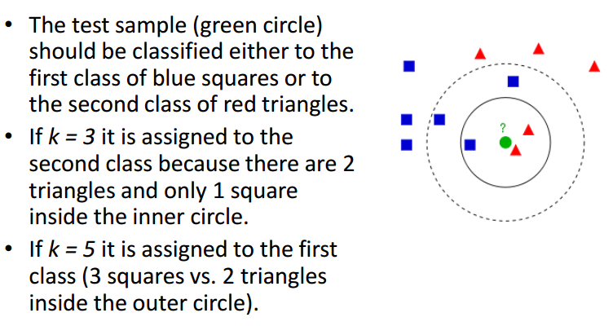
Example

Slide 29
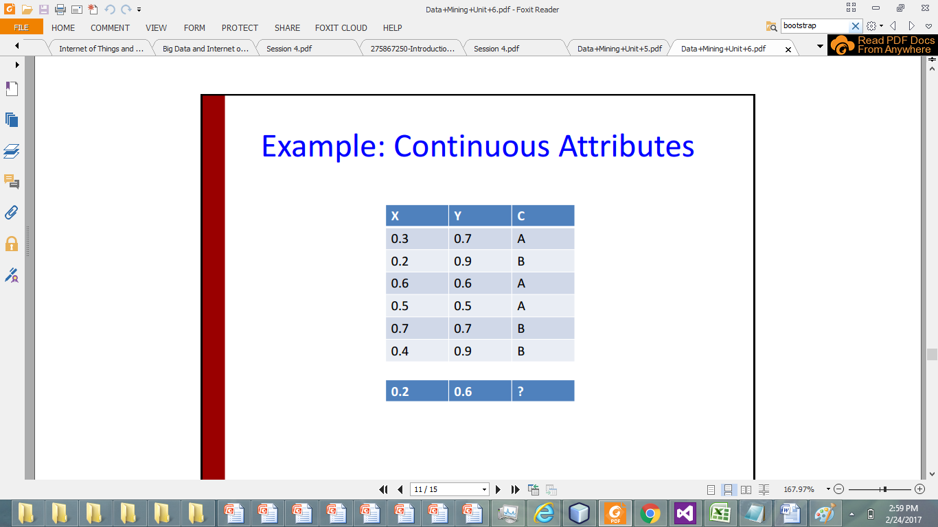
Example: Continuous Attributes
Assume K=3

Slide 30
As K=3, so 3 closest/nearest values are 0.14, 0.30, 0.31
so average their votes:

Slide 31
Votes 2A’s > 1B
Hence Class is A

Slide 32
Example: Solve using KNN
Notes:
Convert into numerical

Slide 33
Convert into Continuous

Slide 34
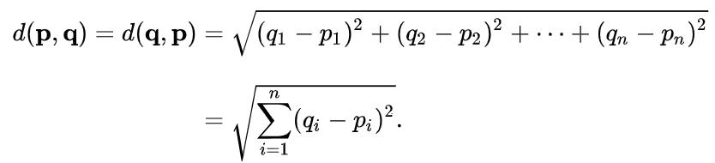
As we know Euclidean Distance

Slide 35
If K=3, select 3 closest/lowest values and average their vote
2 mammals, 1 non-mammal
Hence Mammal is output

Slide 36
If K=5, select 5 closest/lowest values and average their vote
2 mammals, 3 non-mammal
Hence Non-Mammal is output

Slide 37
Limitations
It tends to be slow for large training sets, because the entire set must be searched for each test instance
It performs badly with noisy data, because the class of a test instance is determined by its single nearest neighbor without any “averaging” to help to eliminate noise.
It performs badly when different attributes affect the outcome to different extents—in the extreme case, when some attributes are completely irrelevant— because all attributes contribute equally to the distance formula.
It does not perform explicit generalization

Slide 38
Reducing the Number of Exemplars
The plain nearest-neighbor rule stores a lot of redundant exemplars: it is almost always completely unnecessary to save all the examples seen so far.
A simple variant is to classify each example with respect to the examples already seen and to save only ones that are misclassified.
Discarding correctly classified instances reduces the number of exemplars and proves to be an effective way to prune the exemplar database.

Slide 39
Reducing the Number of Exemplars(Cont’d)
Unfortunately, the strategy of only storing misclassified instances does not work well in the face of noise.
Noisy examples are very likely to be misclassified, and so the set of stored exemplars tends to accumulate those that are least useful.
This effect is easily observed experimentally. Thus this strategy is only a stepping-stone on the way toward more effective instance-based learners.

Slide 40
Pruning Noisy Exemplars
Noisy exemplars inevitably lower the performance of any nearest-neighbor scheme that does not suppress them because they have the effect of repeatedly misclassifying new instances.
A solution is to monitor the performance of each exemplar that is stored and discard ones that do not perform well.
This can be done by keeping a record of the number of correct and incorrect classification decisions that each exemplar makes.

Slide 41
